Slide 1

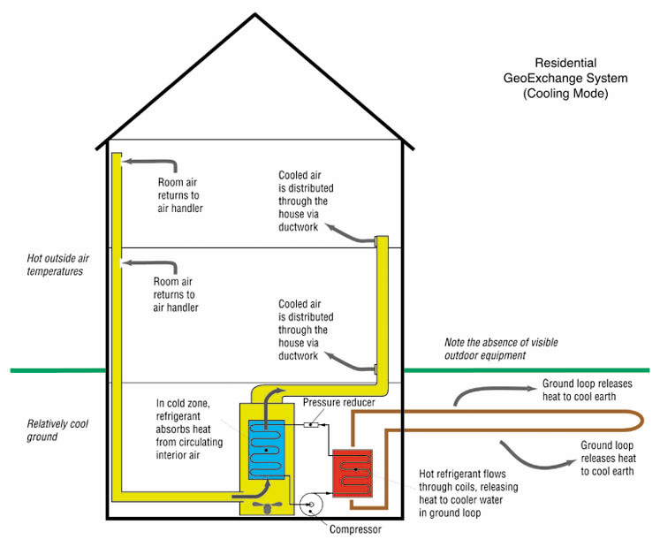
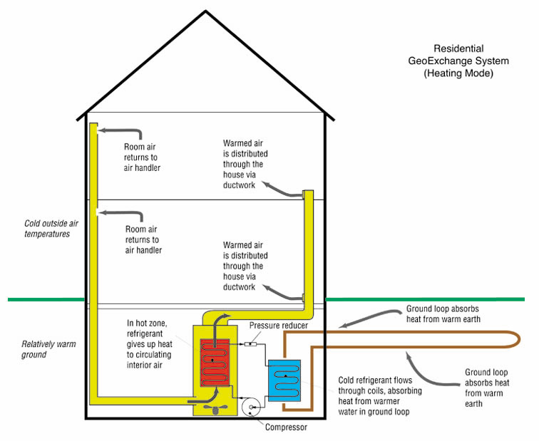
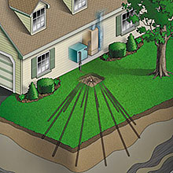
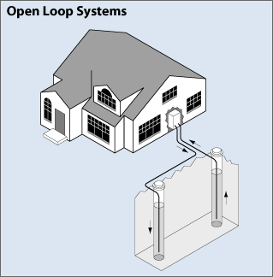
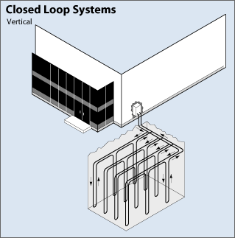
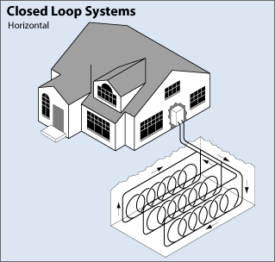
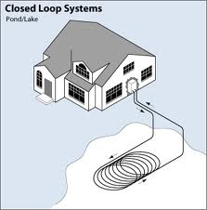
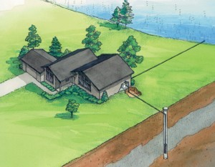
GEOTHERMAL WELLS
What is Geothermal Heating and Cooling?
Conventional heating and cooling systems use air to transfer heat into and out of buildings. Geothermal systems use the nearly constant temperature of the ground as a heat source in the winter and as a heat sink in the summer. Properly designed and installed, these systems can heat and cool efficiently. Because these systems are often intimately connected with underground sources of drinking water, the North Carolina Underground Injection Control (UIC) Program of the Division of Water Quality regulates the construction and operation of these systems in order to keep the ground water suitable for drinking.
What Regulations and Permits Do You Need to Know About?
Proper well construction and maintenance can protect human health and ground water quality, plus help avoid problems with heat pump system operation. As with other well types, only certified well drillers are permitted to construct wells for geothermal heating and cooling systems. Permits are only required for open loop systems. Closed-loop systems are considered “deemed permitted” when constructed and operated in accordance with the rules.
Residential
GeoExchange System
(Cooling Mode)
Residential
GeoExchange System
(Heating Mode)
Vertical Closed Loop Heat Pump Systems
Vertical closed-loop heat pump systems operate by recirculating a liquid or gas within continuous piping that is enclosed in a well. The continuous piping exchanges heat with the subsurface without direct contact between the recirculating liquid and the subsurface. These types of systems are differentiated according to the nature of the recirculating fluid:
Closed-loop mixed fluid heating and cooling systems include traditional glycol-based closed-loop systems as well as “direct expansion” or “direct exchange” systems. These systems are deemed permitted when constructed and operated in accordance with the rules. The person responsible for construction of the wells must submit notification of intent to construct prior to construction of the wells.
Closed-loop water-only geothermal injection wells circulate potable water within a closed-loop of pipe. As like the closed-loop mixed fluid wells, these wells are deemed permitted and the person responsible for construction of the wells must submit notification of intent to construct prior to construction of the wells.
Open Loop Heat Pump Systems
Open loop heat pump systems operate by withdrawing water from a well, circulating it through the heating/cooling system, and returning the water to the source well or another well. This system is often used with an existing water supply well and utilize separate wells for water supply and water return or may use a single well for both supply and return. The wells used for these systems have the same grouting and casing requirements as water supply wells. A permit is required to construct and operate this type of system, but currently there is no permit application fee.
Four Main Types of Systems
Vertical Closed Loop Heat Pump Systems
Horizontal Closed Loop Heat Pump Systems
Open Loop Heat Pump Systems
"Pump and Dump" Heat Pump Systems
Closed-loop geothermal heat pump injection wells of either type must be grouted the full length of the borehole. In addition, the well must be constructed so that different aquifers or zones are not interconnected by the borehole. The types of approved grouts are the same as for water supply wells listed under 15A NCAC 02C .0100.
All closed-loop wells have setback requirements from potential sources of contamination. For a complete list of setbacks, please refer to the 15A NCAC 02C .0200 rules. In addition to State requirements, Counties or municipalities may have additional requirements for construction and operation of geothermal heat pump systems.
Following receipt of an application for a permit for this type of well, an inspector will visit the site to determine its suitability for construction of the proposed injection well. If the application is approved, a permit for construction and operation of the injection well will be issued. After construction of the well and heat pump system is complete, the inspector will return to the site to inspect the well and collect samples of the system’s influent and effluent. If the effluent does not meet the State’s groundwater quality standards, the permittee will be required to take action to identify and correct the problem; otherwise, they will be allowed to continue operation of the system as long as they keep the permit valid. Permits are usually issued for five year intervals.
Horizontal Closed Loop Heat Pump Systems
Horizontal closed-loop heat pump systems operate just like vertical closed-loop systems except that the continuous piping is placed in trenches in the ground. A variation of this type has the piping located in a pond or lake, exchanging heat with the water body instead of the ground. A permit is not required for this type of system, but interested parties should check with county and municipal authorities for any other applicable rules and regulations.
"Pump and Dump" Heat Pump Systems
So-called “pump and dump” systems are heat pump wells that withdraw groundwater but do not re-inject the heat pump effluent. They are regulated only as water supply wells under 15A NCAC 2C .0100, “Well Construction Standards – Criteria and Standards Applicable to Water Supply Wells and Certain Other Wells”. No State permit is required for these systems unless the total design flow rate is greater than or equal to 100,000 gallons per day. Interested parties should check with county and municipal authorities for any other applicable rules and regulations.

